Slide 1
Predicting Used Car Prices

Slide 2
Overview:
This solution develops a machine learning model to predict used car prices using vehicle characteristics and market data from major metro cities.
The objective is to improve pricing accuracy, optimize inventory decisions, and support buyers and sellers with reliable, data-driven insights.
The model also helps identify the most important factors that influence car prices, enabling smarter business strategies in the used car marketplace.

Slide 3
Project analysis slide 2
Analysis Workflow
Data understanding & EDA
Data Preprocessing &Feature Engineering
Used Car Price Prediction
Conclusion
Model Preparation and Feature Importance
Prediction Error Analysis
Model evaluation & validation

Slide 4
Data Overview :
The dataset has 1064 records and 19 attributes. Key fields include:
Numerical features: Kilometer (driven), ModelYear, Warranty (dealer warranty 0/1), QualityScore, and Price (target).
Categorical features: Company, Model, Variant, FuelType, Colour, BodyStyle, TransmissionType, Owner (1st/2nd owner, etc.), DealerState, City, etc.
Missing values: ~714 missing in TransmissionType ,1 in FuelType and 1064 in CngKit, handled by dropping/encoding.
Price cleaning: Original Price was a string (e.g. “5.75 Lakhs”); we stripped “Lakhs” and converted to float (so 5.75).
Basic EDA showed average prices by group: Diesel and hybrid vehicles fetched higher prices (avg ₹10.9L and ₹18.75L respectively) than petrol or CNG cars. First-owner cars had higher mean price (≈₹8.64L) than later-owner vehicles. Luxury brands (e.g. MG, Mercedes) led with the highest average used prices (~₹17–18L). These insights confirm that factors like fuel type, ownership count, brand and warranty strongly influence resale value.

Slide 5
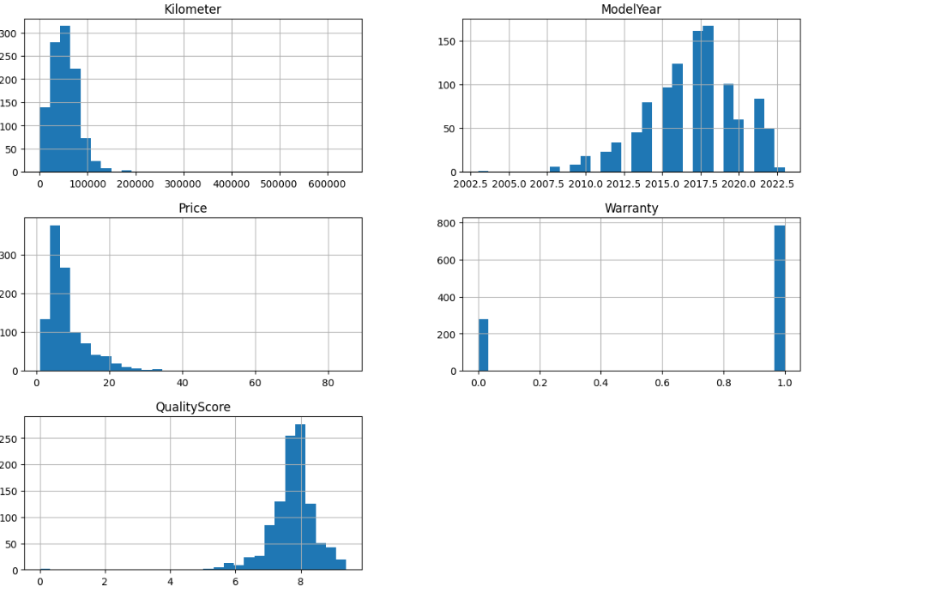
Exploratory Data Analysis(Numerical Features)
Observations:
Higher mileage and older cars generally have lower prices.
Cars with warranty and higher quality scores command higher prices.
Recent model years show stronger price retention.

Slide 6
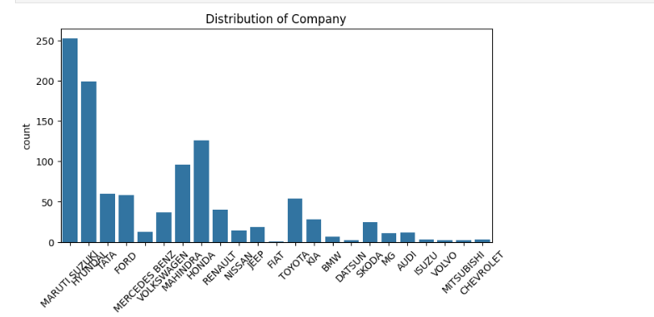
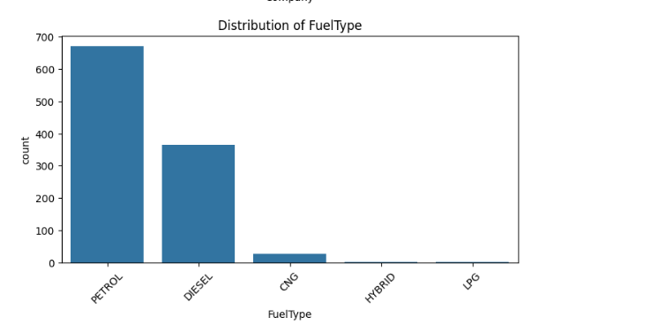
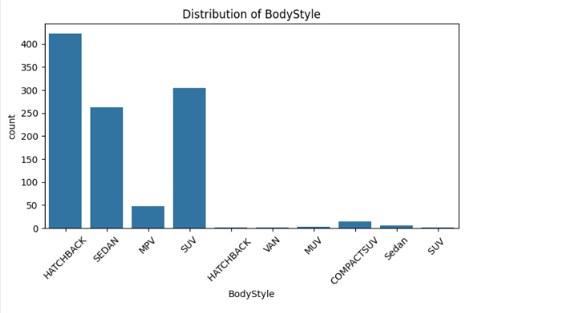
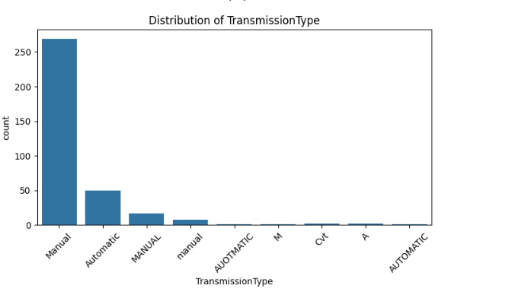
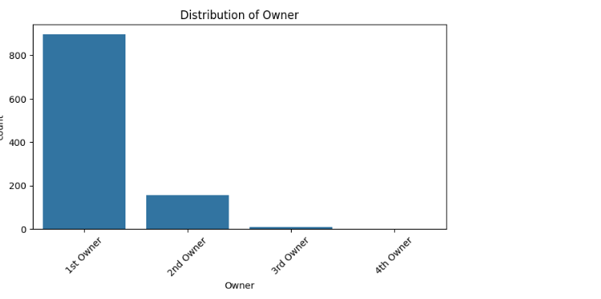
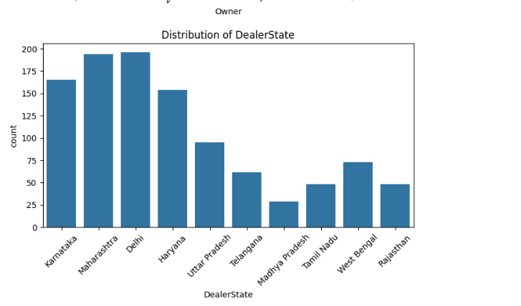
Exploratory Data Analysis(Categorical Features)

Slide 7
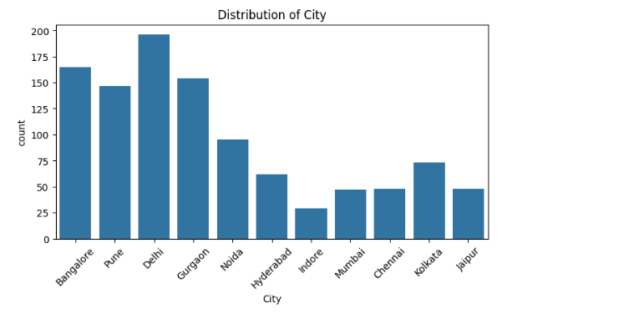
Observations:
Petrol and Diesel vehicles dominate the dataset.
Hatchback, Sedan, and SUV are the most common body types.
Majority of cars are from 1st owner category.
Manual transmission is more prevalent than automatic

Slide 8
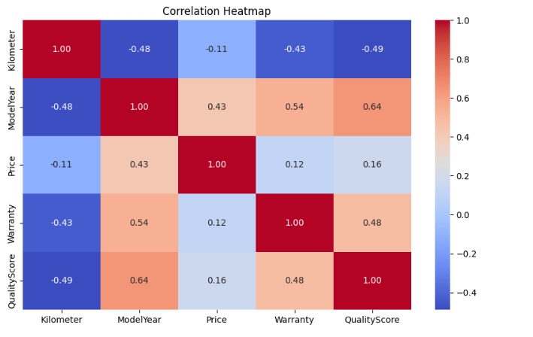
Feature Relationship Analysis
Observations:
Price increases with newer model year and higher quality score.
Higher mileage has a negative impact on car value.
Warranty shows positive influence on pricing.
Quality score has a positive impact on car value.
Price is moderately influenced by overall vehicle condition.

Slide 9
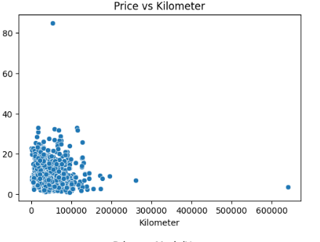
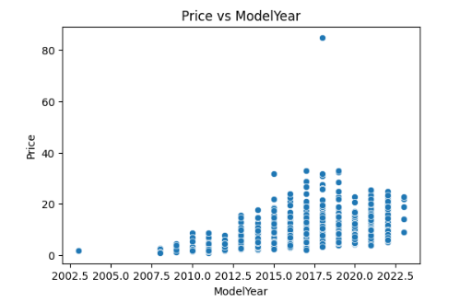
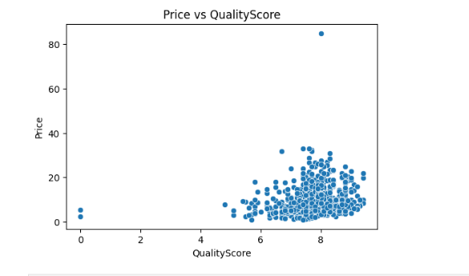
Price Relationship Analysis
Observations:
Price decreases as mileage increases.
Newer model year vehicles command higher prices.
Higher quality score is associated with higher car value.
These relationships validate the importance of selected features.

Slide 10
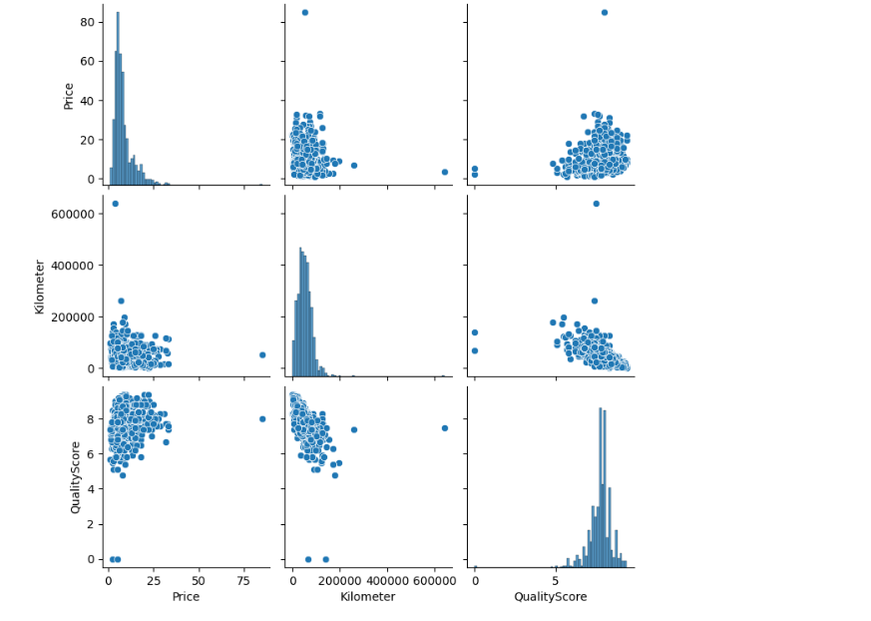
Multivariate Relationship Analysis
Observations:
Mileage, quality score, and price show consistent interaction patterns.
Increasing mileage negatively impacts overall vehicle condition and price.
Combined feature relationships support robust model prediction.

Slide 11
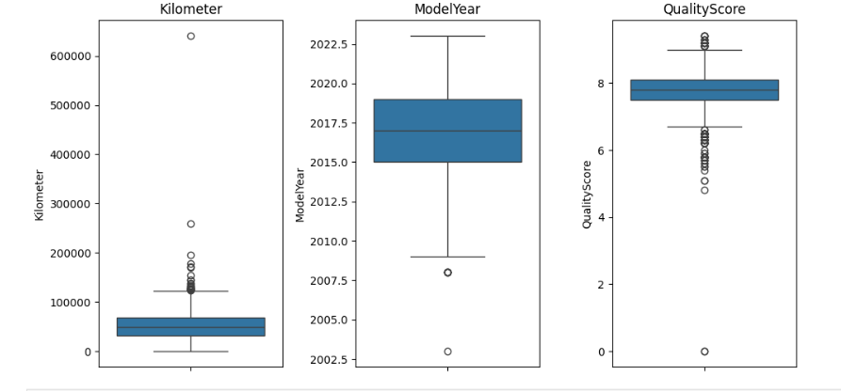
Outlier & Distribution Analysis
Observations:
Mileage contains several high-value outliers.
Model year is concentrated around recent years.
Quality score remains stable with few extreme values.
Outliers were carefully handled during preprocessing.

Slide 12
Data Preprocesssing & Feature Engineering
▪ Missing Value Treatment:
Handled missing values in key categorical features such as Fuel Type and Transmission Type by imputing with “Unknown” to preserve valuable records.
▪ Outlier Treatment:
Detected and treated outliers in numerical features (Kilometer, QualityScore) using the IQR method to reduce noise and improve model robustness.
▪ Feature Creation:
Created a new feature Car Age from Model Year to capture the impact of vehicle aging on price.
▪ Categorical Feature Encoding:
Converted categorical variables such as Company, FuelType, Owner, City, and Transmission into numerical form using encoding techniques.
▪ Feature Scaling:
Standardized numerical features including Kilometer, ModelYear, QualityScore, and CarAge to ensure consistent model training.

Slide 13
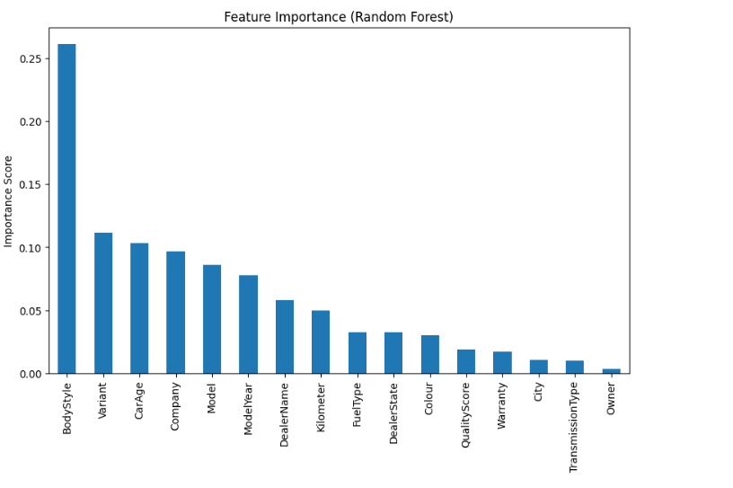
Model Preparation and Feature Importance
Splitting the Dataset
We divided the dataset into training (80%) and testing (20%) sets.
This ensures that the model learns from one portion of the data and is evaluated on unseen data for reliable performance assessment.
Separating Features and Target
The dataset was separated into two parts:
X (Independent Variables) – all input features influencing the car price.
y (Target Variable) – the Used Car Price that the model aims to predict.
FEATURE IMPORTANCE:
The Random Forest model was used to identify the most influential features affecting used car prices.
The results show that Body Style, Variant, Car Age, Company, Model, and Model Year have the strongest impact on price prediction, while factors such as Transmission Type, City, and Ownership have relatively lower influence.

Slide 14
Model Selection
Models used:
• Decision Tree Regressor: Decision Tree is used as a baseline regression model because it is simple, easy to interpret, and effective in capturing non-linear relationships between the input features and the car price.
• Random Forest Regressor: Random Forest is a robust ensemble learning algorithm and was used mainly for feature importance analysis and for improving prediction stability.
• Gradient Boosting Regressor: Gradient Boosting is an advanced ensemble technique that improves model performance by sequentially correcting errors of weak learners.
• XGBoost Regressor: XGBoost is a powerful boosting algorithm used for regression problems. It was selected as the final model because it achieved the best accuracy and generalization performance on unseen data.

Slide 15
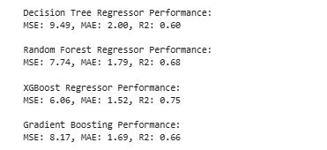
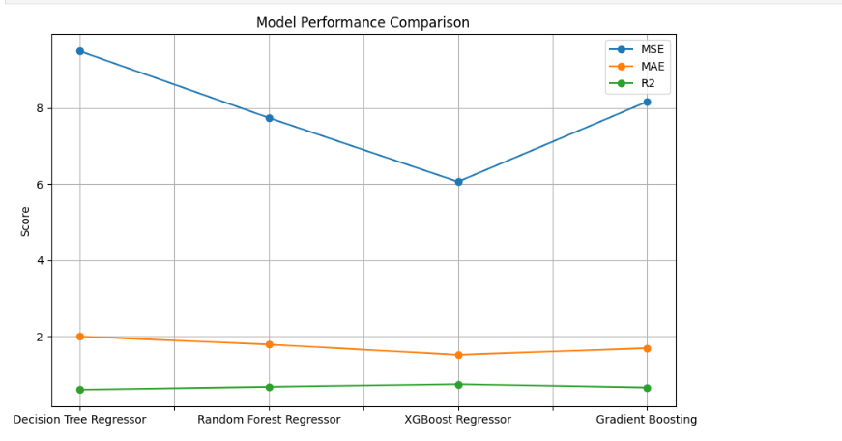
Experimental Results
XGBoost Regressor:
XGBoost achieves the lowest error (MSE = 6.06, MAE = 1.52) and the highest R² score (0.75), indicating superior prediction accuracy.
Random Forest & Gradient Boosting Regressor:
Random Forest performs consistently well with moderate error, while Gradient Boosting improves over Decision Tree but does not surpass XGBoost.
Decision Tree Regressor:
Decision Tree provides a useful baseline but shows higher error compared to ensemble models.

Slide 16
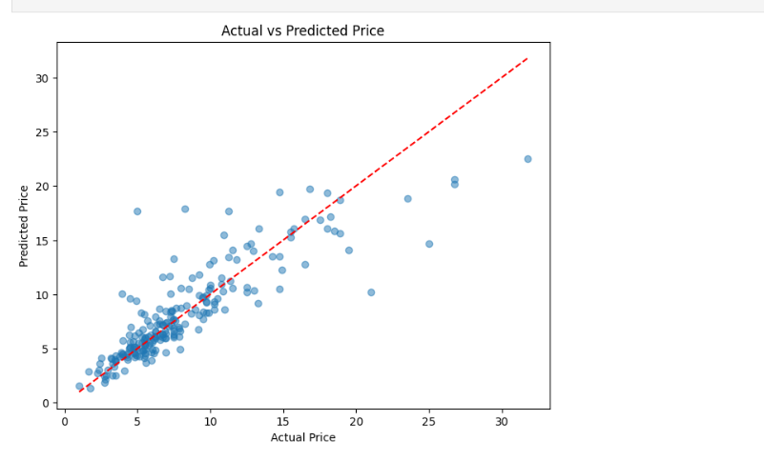
Final Model Results
(Actual vs Predicted Price)
The predicted prices closely follow the actual prices, showing strong alignment with the ideal prediction line.
This demonstrates that the final XGBoost model is highly effective in capturing real market behavior and producing accurate price estimates.

Slide 17
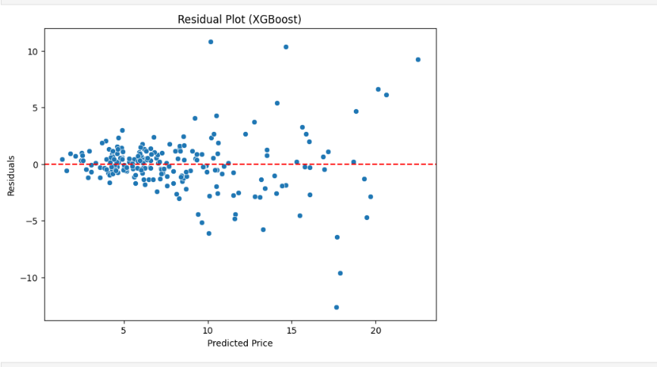
Model Validation
The residuals are randomly distributed around zero, indicating that the model does not show systematic bias and is well-fitted across different price ranges.
This confirms the reliability and stability of the final prediction model.

Slide 18
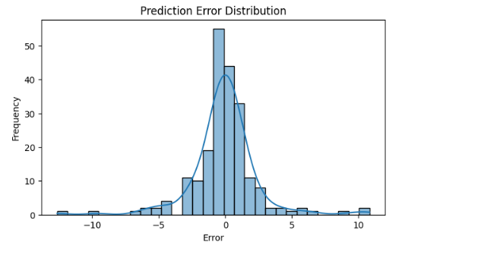
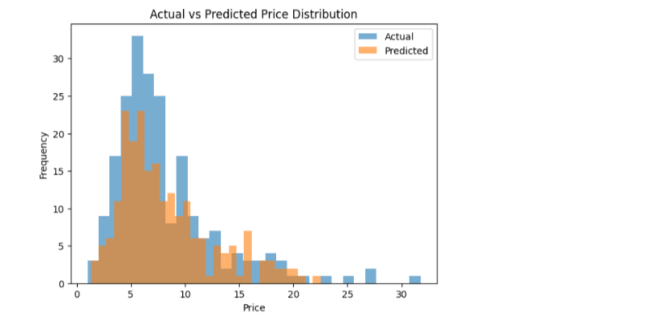
Prediction Error Analysis
The prediction errors are concentrated around zero, indicating that the model produces unbiased and reliable estimates across different price ranges.
The predicted price distribution closely follows the actual price distribution, demonstrating strong agreement between model predictions and real market values.
This confirms that the model generalizes well and maintains consistent performance on unseen data.

Slide 19
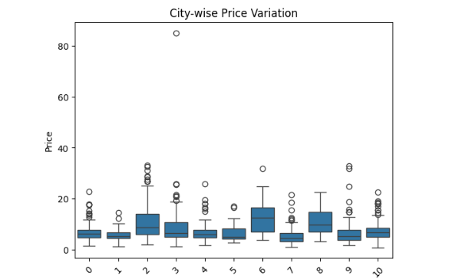
City-wise Price Analysis
Car prices vary significantly across different cities, reflecting the influence of local demand, market conditions, and buyer preferences.
Some cities consistently show higher median prices, while others display greater price variability, indicating differing levels of market competitiveness.
This insight helps businesses tailor pricing strategies for specific regions and optimize inventory distribution.

Slide 20
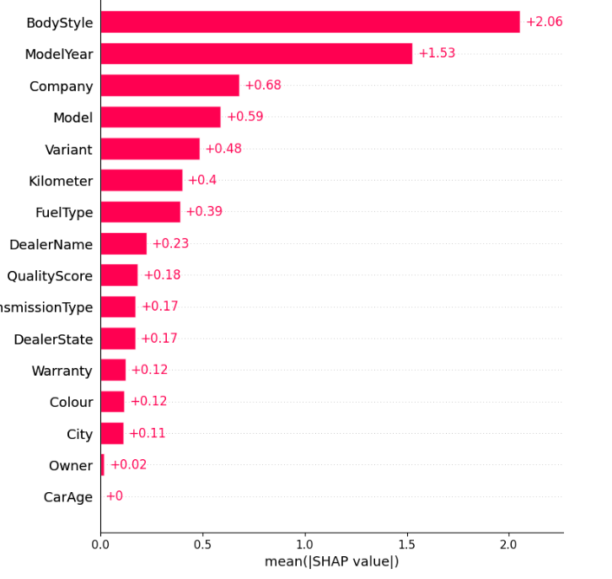
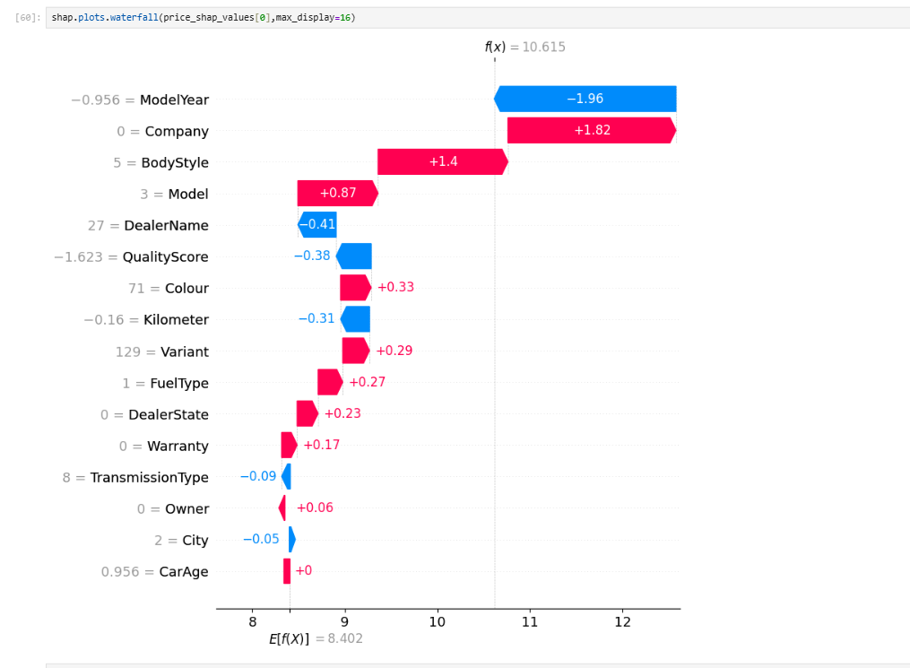
Model Interpretability -Shap Analysis
Observations:
Base Value (E[f(x)]): ~8.40 Lakhs — this is the average model prediction across all cars.
Final Prediction (f(x)) = 10.615 Lakhs — after all SHAP values are added.
Negative Contributors (Pushed price down):
ModelYear = -0.956 (older car model)
DealerName = 27 and QualityScore = -1.62 — reduced the confidence or trust in quality.
Kilometer = -0.16` — higher mileage decreases price.
Positive Contributors (Pushed price up):
Company = 0 and BodyStyle = 5` — strong influence adding +1.82 and +1.4 Lakhs.
Model = 3, Colour, Variant, and FuelType — all added small positive values.
Observations:
BodyStyle is the most influential feature, contributing an average of +2.06 Lakhs to the model’s predictions.
ModelYear and Company also have strong impact, suggesting that newer models and certain brands significantly raise the predicted price.
Features like Colour, Warranty, City, and Owner had relatively minor effects.
CarAge appears to have no impact, possibly due to being correlated with other variables (e.g., ModelYear).

Slide 21
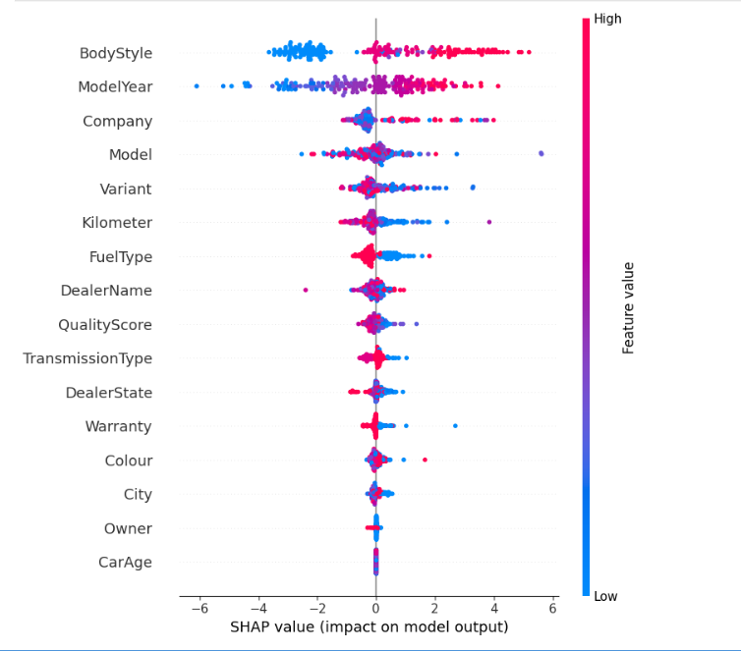
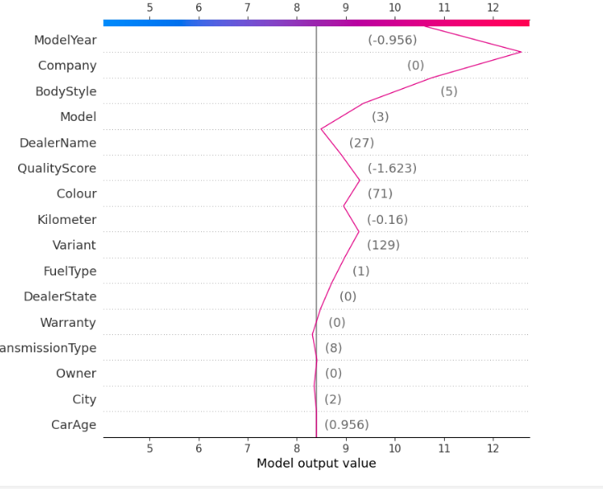
Observations:
BodyStyle, ModelYear, and Company are the most influential features overall.
For BodyStyle, low values (blue) tend to reduce the predicted price (shift left), while high values increase it.
ModelYear: Newer cars (red) generally increase the price (SHAP value > 0), older ones (blue) reduce it.
Kilometer: Lower mileage (blue) tends to increase price, while higher mileage (red) pushes the prediction down.
Several features like Colour, Owner, City, and CarAge show low spread and small impact.
Observations:
BodyStyle, ModelYear, and Company are the most influential features overall.
For BodyStyle, low values (blue) tend to reduce the predicted price (shift left), while high values increase it.
ModelYear: Newer cars (red) generally increase the price (SHAP value > 0), older ones (blue) reduce it.
Kilometer: Lower mileage (blue) tends to increase price, while higher mileage (red) pushes the prediction down.
Several features like Colour, Owner, City, and CarAge show low spread and small impact.
The SHAP decision plot reveals how individual features contributed to the predicted car price.
The prediction starts from a base value of approximately 8.5 Lakhs.
Features such as Variant, Company, and CarAge had strong positive contributions, increasing the final predicted value.
In contrast, features like ModelYear and QualityScore had negative contributions, slightly lowering the price.
The cumulative effect of these features led to a final prediction of approximately 12 Lakhs for this specific car.

Slide 22
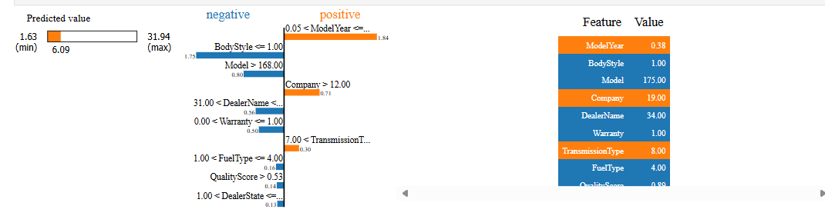
LIME Explainer
Predicted Price: ₹6.09 Lakhs for this specific used car.
Positive Contributions:
Company = 19 and ModelYear = 1 increased the prediction by ~1.84 Lakhs and ~0.71 Lakhs respectively.
Negative Contributions:
BodyStyle = HATCHBACK decreased the prediction significantly by ~1.75 Lakhs.
Other features such as QualityScore, Model, and DealerName also had small negative impacts.

Slide 23
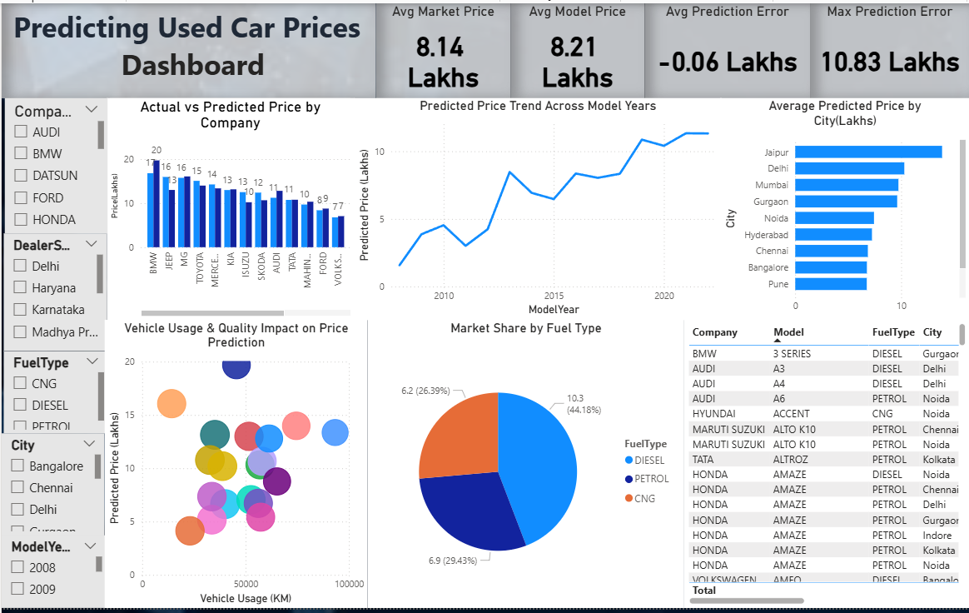
A Power BI dashboard was developed to visualize key patterns in the used car market.
The bar chart presents average car price by company, helping compare brand-wise resale value.
The fuel-type donut chart illustrates the distribution of petrol, diesel, and CNG cars in the dataset.
The Kilometer vs Price visual demonstrates that higher kilometers driven generally lead to lower resale prices.
KPI cards provide a quick high-level summary of important metrics such as average price and total vehicles.
The interactive filters allow analysis based on city, dealer state, and body style for localized insights.

Slide 24
Conclusion
Key Outcomes
The machine learning model successfully captures used car pricing patterns across major metro cities.
Key pricing drivers such as vehicle age, mileage, model year, quality score, body style, and brand were identified.
The final model provides reliable and consistent price predictions aligned with real market behavior.
Limitations:
The model is trained on a relatively small dataset of 1,064 records, which may limit its ability to generalize to a broader used-car market.
A smaller dataset may not fully capture the diversity of the used car market across different regions and brands.
The limited sample size increases the risk of model bias toward patterns present in the available data.
With more data, the model could learn more robust relationships between features and car prices.
Hyperparameter tuning was attempted using Grid Search/Random Search, but it reduced model accuracy, so the original model was retained.
Business Impact
Enables accurate pricing recommendations for buyers and sellers.
Improves inventory optimization and turnover for dealers.
Strengthens customer trust through transparent pricing.
Supports smarter regional and market-level decisions.

Slide 25
Deployment Strategy (Prototype)
  The trained machine learning model was saved and loaded in the application for reuse.
Web-Based Interface (Implemented):
  The model has been deployed as a Streamlit web application on localhost.
  Users can input car details through an interactive UI and receive instant predictions.
Real-Time Inference:
  The model is loaded in memory when the app starts, enabling low-latency, real-time predictions.
Input Processing & Validation (Prototype Level):
  User inputs are collected, preprocessed, and formatted before being passed to the model.
Future Deployment Plan (Scalable Strategy):
  Host the Streamlit app on Streamlit Cloud / Render / AWS for public access.
  Alternatively, expose the model as a Flask/FastAPI REST API for integration with other systems.
Future Scope
The model can be deployed as a pricing intelligence tool within the client’s marketplace platform.
Integration with real-time market data can enable dynamic pricing updates.
Additional behavioral and demand indicators can further enhance prediction accuracy.

Slide 26
Thank You

